Slide 1
Movie Recommendation
Based on Encoder and K-Means
Zhaoxi Chen zc1134
Shangwen Yan sy2160

Slide 2
Datasets
users
MovieLens
Number of users:7120
Number of Movies:27278
Relevant information:
Movies’ ratings,genres,tags given by users
movies
features(rating,mean_rate,genre)

Slide 3
Structure
User_i
kmeans
encoder
clusters
Hidden features

Slide 4
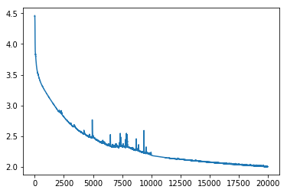
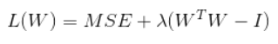
Training progress
encoder
decoder
Encoder part:
First, we train an autoencoder to make the decoded and input matrix as similar as possible.
To make sure AE’s weights are orthonormal , we add penalty to MSE loss ：
Hidden features
Notes:
Train the encoder and k-means separately

Slide 5
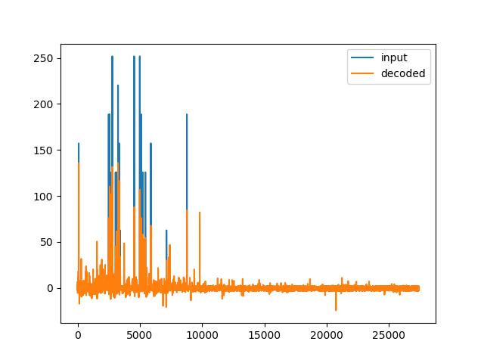
Training progress
The encoded tensor represents input tensor well, but with fewer dimensions, which makes it easier for clustering in k-means part.
k-means part:
Then use encoded tensor to do a k-means clustering which generates 9 clusters of user-groups.

Slide 6
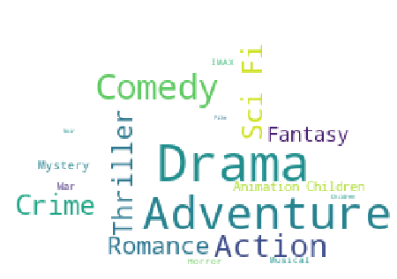
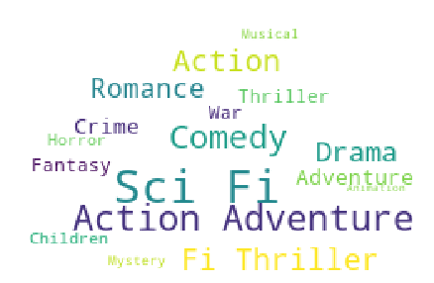
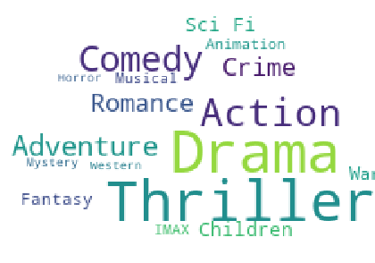
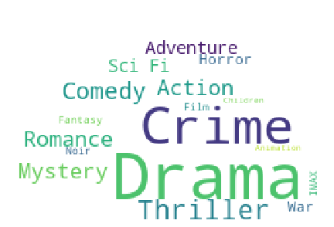
Clusters
For each cluster(user_group), we sum up users’ ratings for each movie and sort the movies by rating desc.
Then use the top 50 movies’ genres to generate a word cloud to see which kind of movie is popular in that user group.

Slide 7
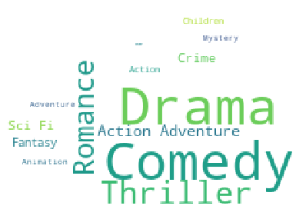
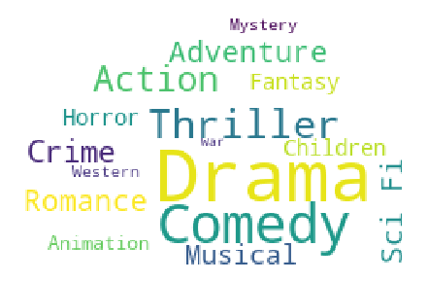
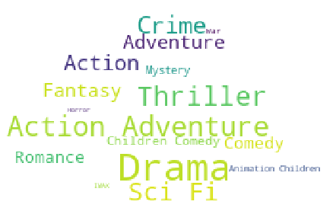
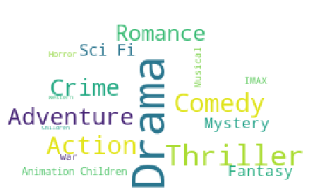
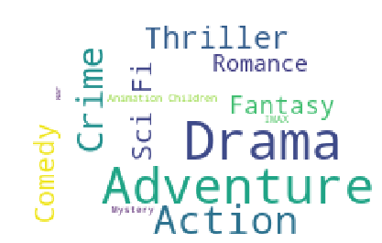
Clusters

Slide 8
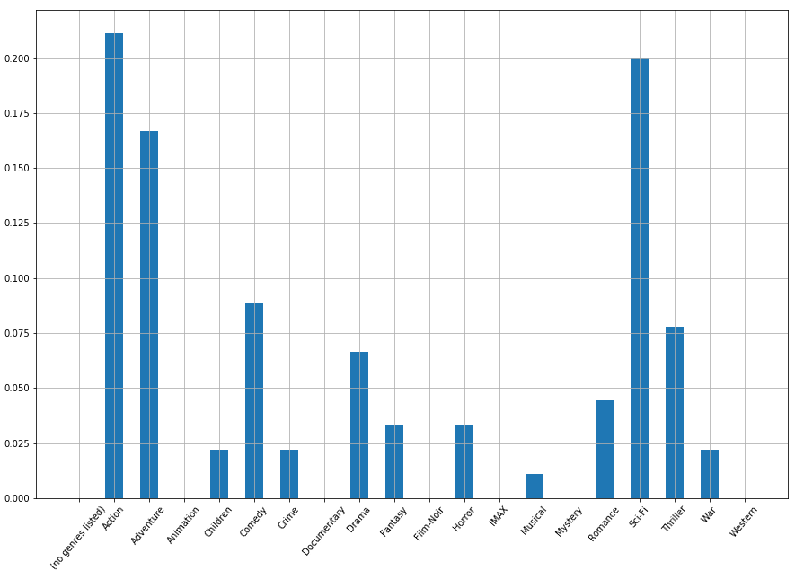
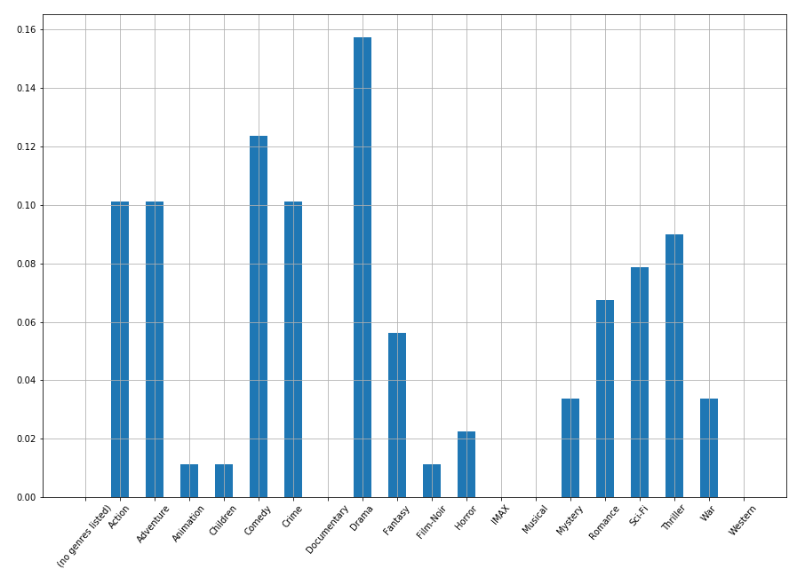
Clusters and Genres
Cluster 1
Cluster 2
Drama(15.5%)
Comedy(12.5%)
Action(21%),
Sci-Fi(20%)
Adventure(16%)

Slide 9
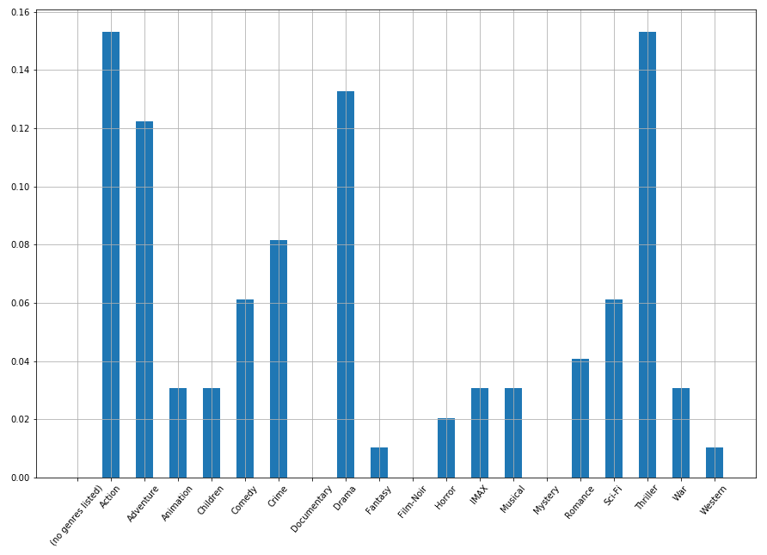
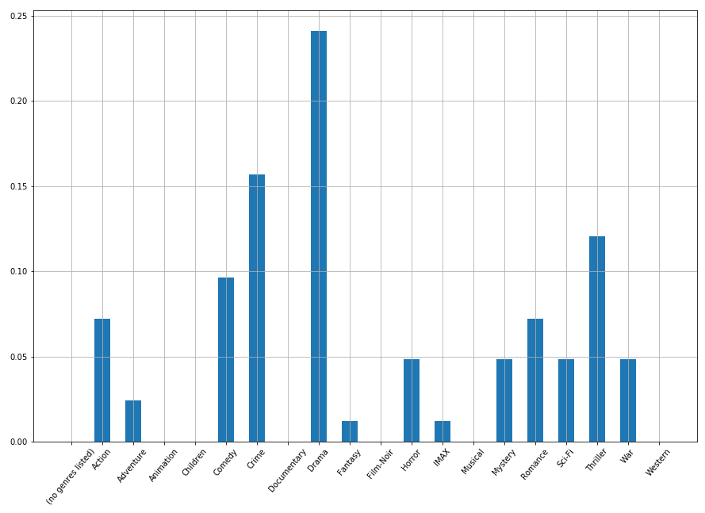
Clusters and Genres
Cluster 3
Cluster 4
Drama(24.5%)
Crime(15.5%)
Thriller(12%)
Action(15.5%)
Thriller(15.5%)

Slide 10
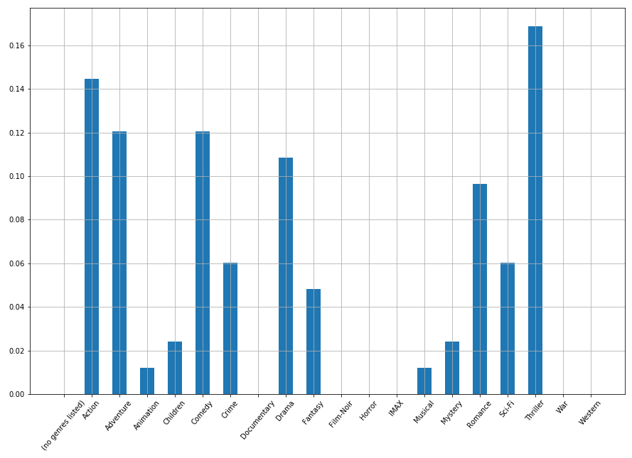
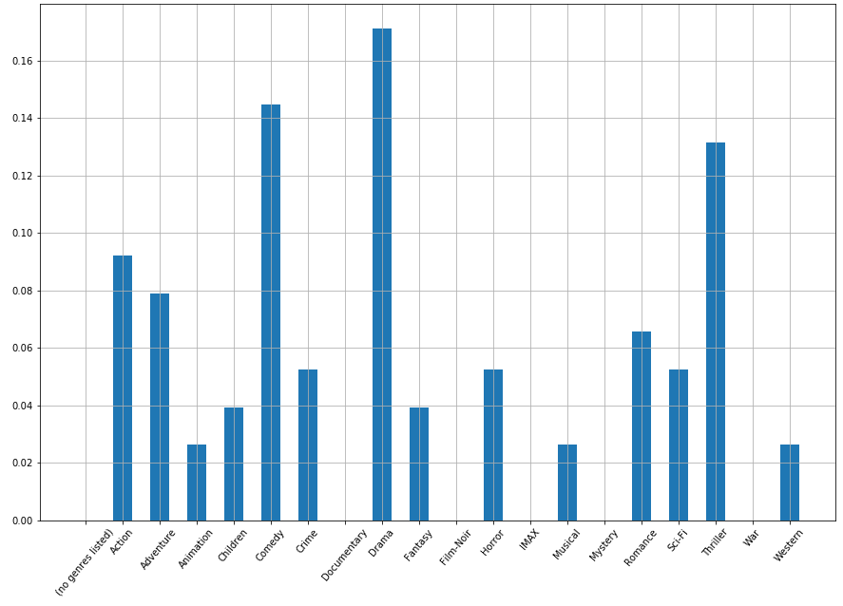
Clusters and Genres
Cluster 5
Cluster 6
Thriller(16.5%)
Action(14.5%)
Adventure(12%)
Drama(15%)
Comedy(14.5%)
Thriller(13%)

Slide 11
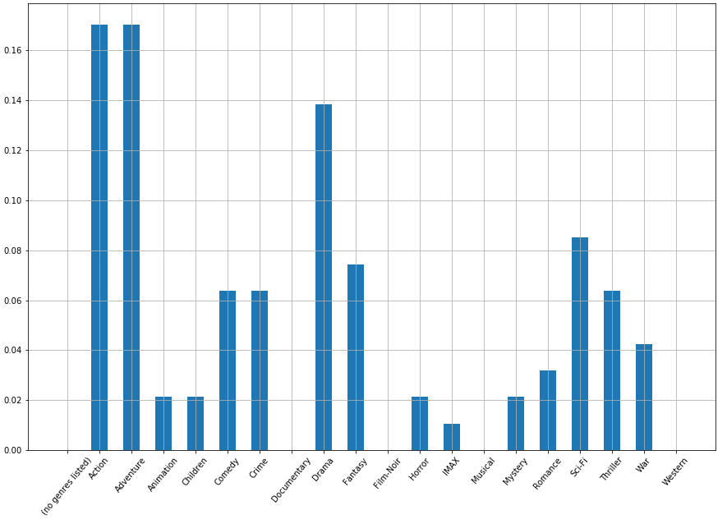
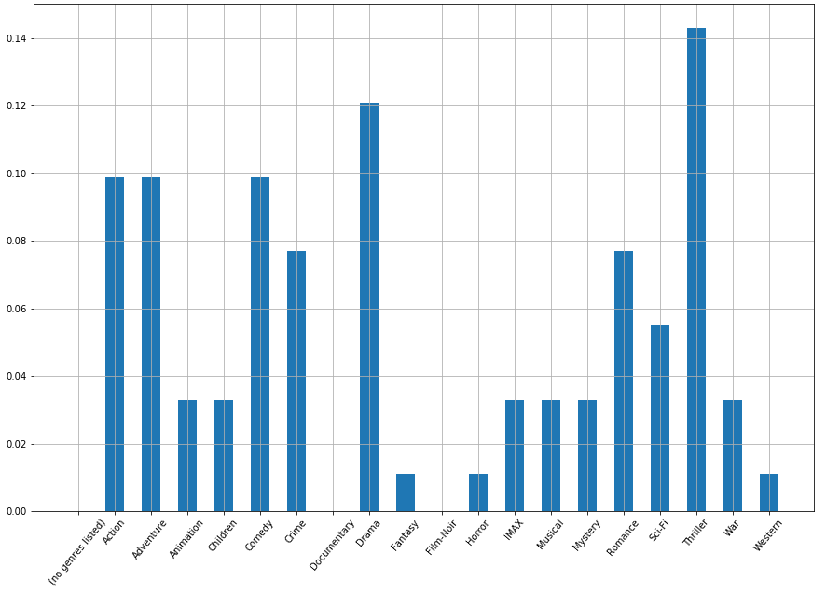
Clusters and Genres
Cluster 7
Cluster 8
Adventurer(15%)
Action(15%)
Drama(13.75%)
Thriller(14.5%)
Drama(12.25%)

Slide 12
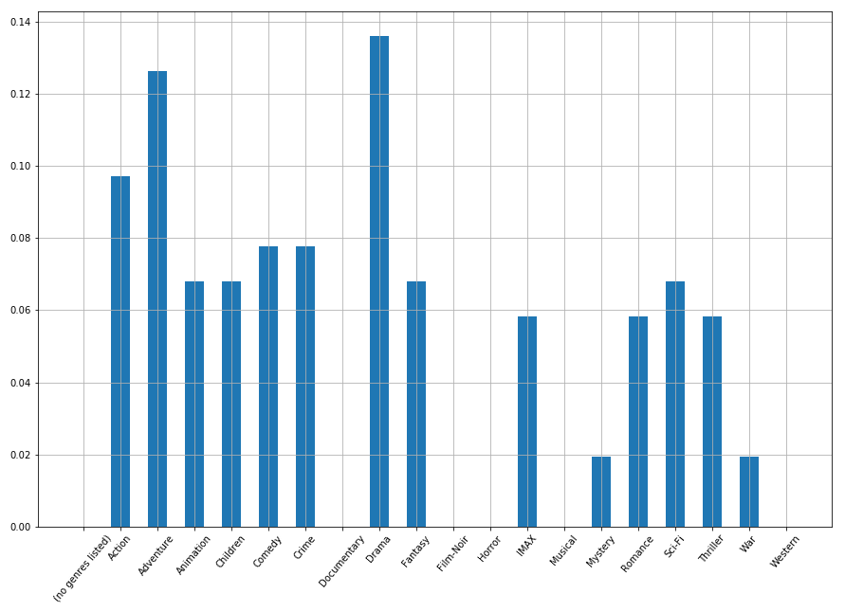
Clusters and Genres
Cluster 9
Drama(13.5%)
Adventure(12.75%)

Slide 13
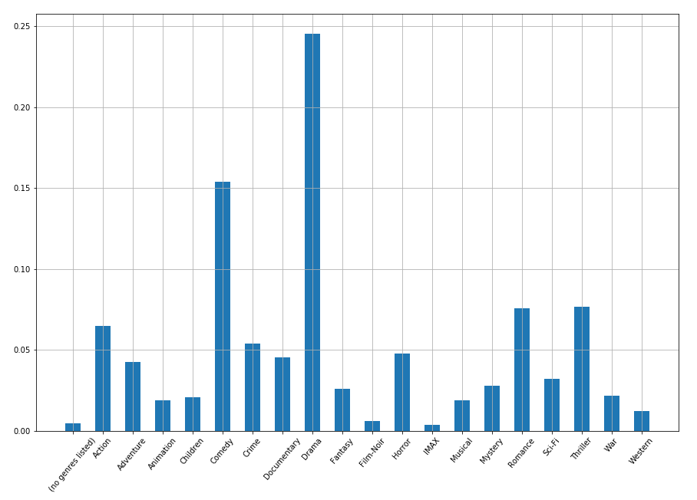
Genres
As we can see, some genres show up frequently, we do a genres analysis among all movies(no clusters).
From the plot we could find some genres, like Drama and Comedy, are ‘common types’ , so that’s the reason why they show up in most clusters.
To make the difference easy to observe, we rescale the frequency of genres based on their probability among all movies

Slide 14
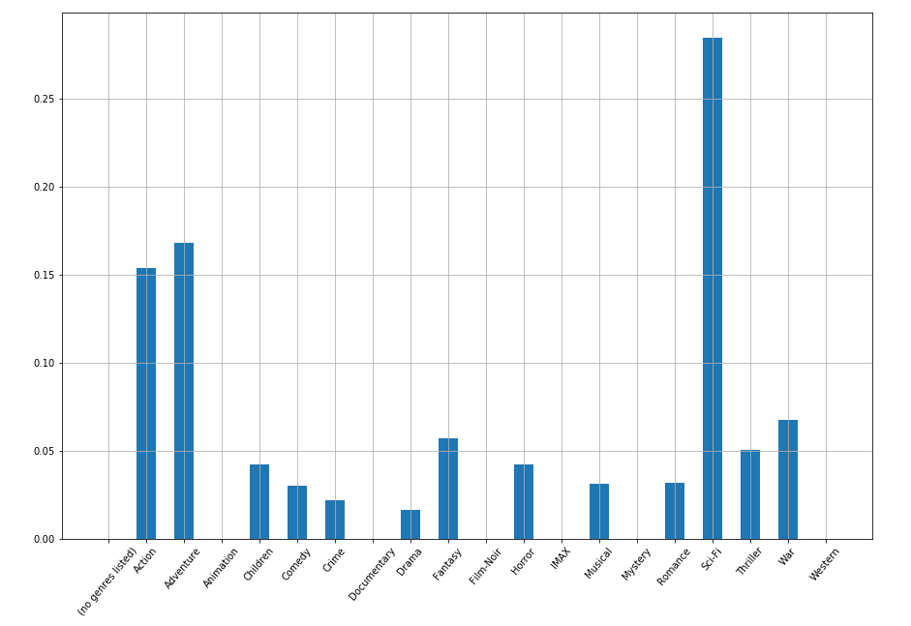
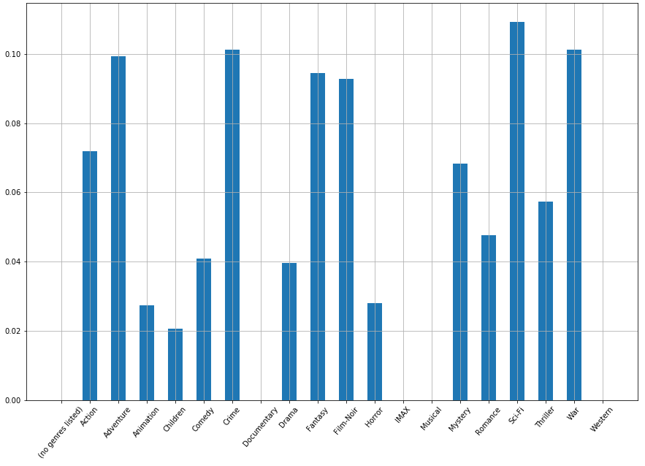
Genres after scaling
Cluster 1
Cluster 2
Sci-Fi (28%)
Adventure(17%)
Action (15.5%)
Sci-Fi (11%)
War (10.25%)
Crime (10.25)

Slide 15
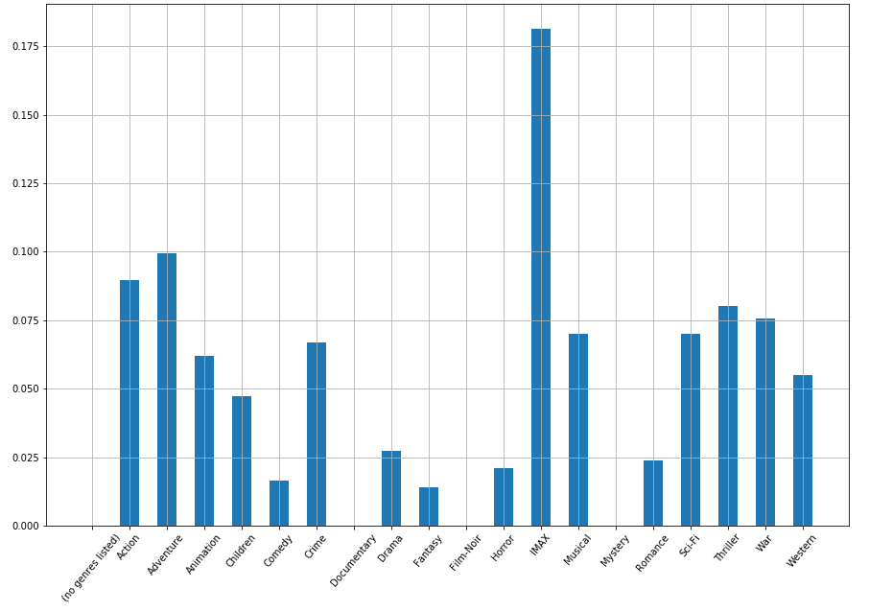
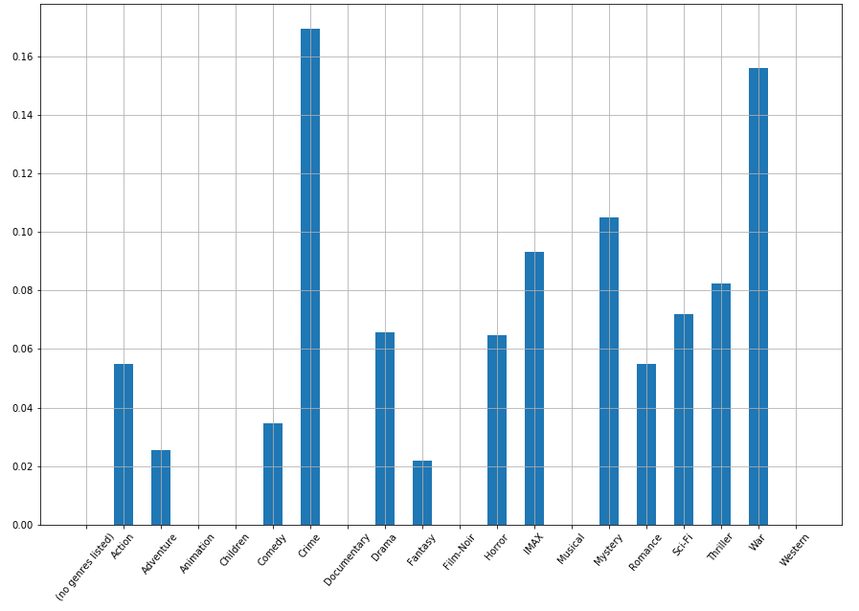
Genres after scaling
Cluster 3
Cluster 4
IMAX (18%)
Adventure (10%)
Crime (16.5%)
War (15.5%)
Mystery(10.5%)

Slide 16
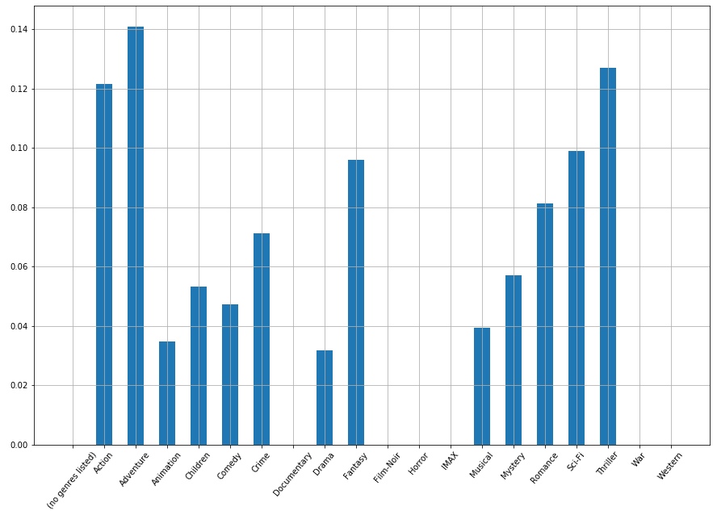
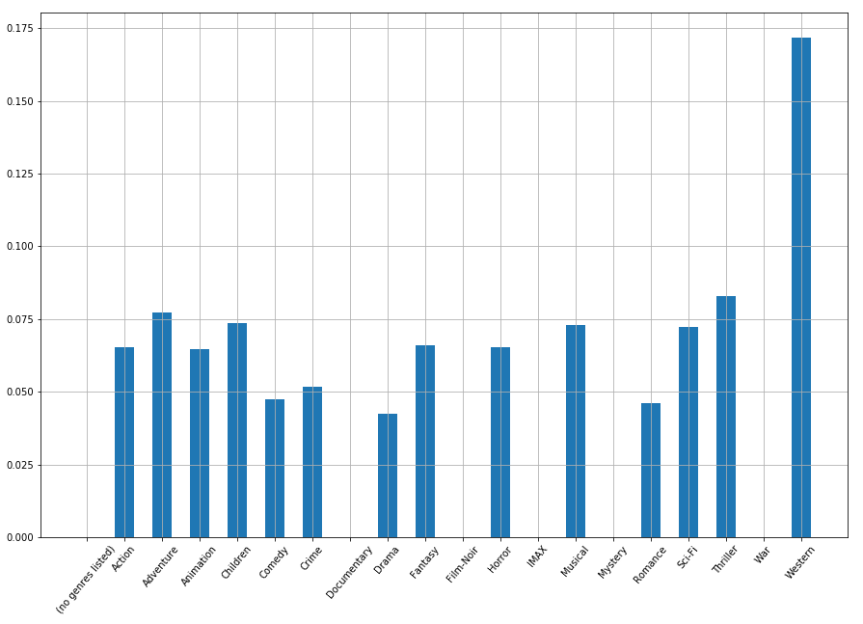
Genres after scaling
Cluster 5
Cluster 6
Adventure (13%)
Thriller (13%)
Action (12%)
Western (17%)

Slide 17
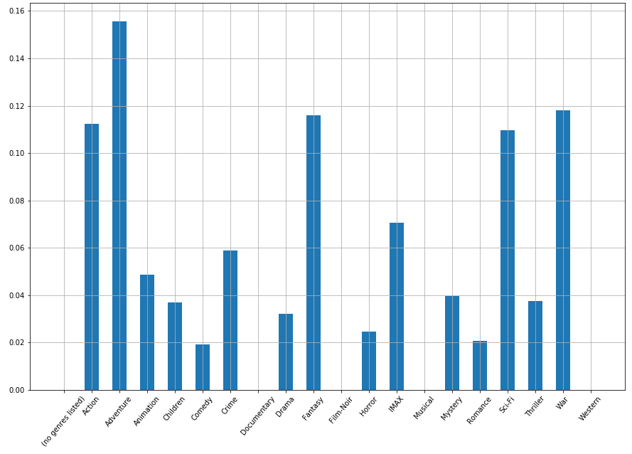
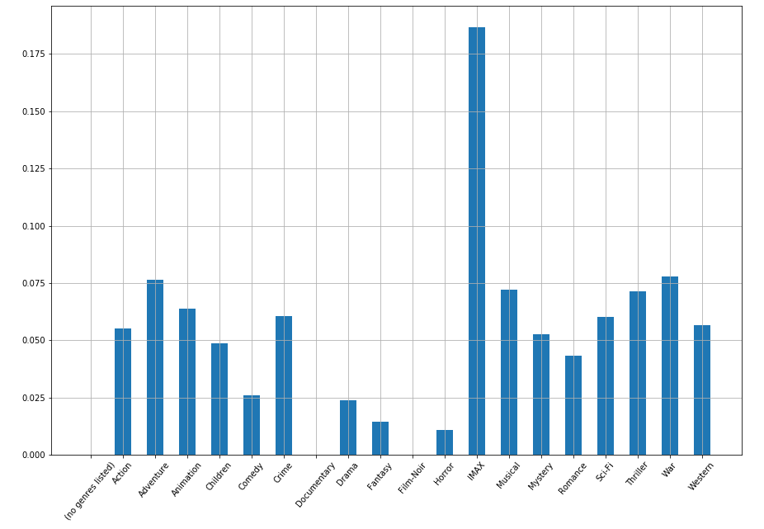
Genres after scaling
Cluster 7
Cluster 8
Adventure (15.5%)
War(13.75%)
Fantasy (11.5%)
IMAX (18%)
War (8%)
Adventure (8%)

Slide 18
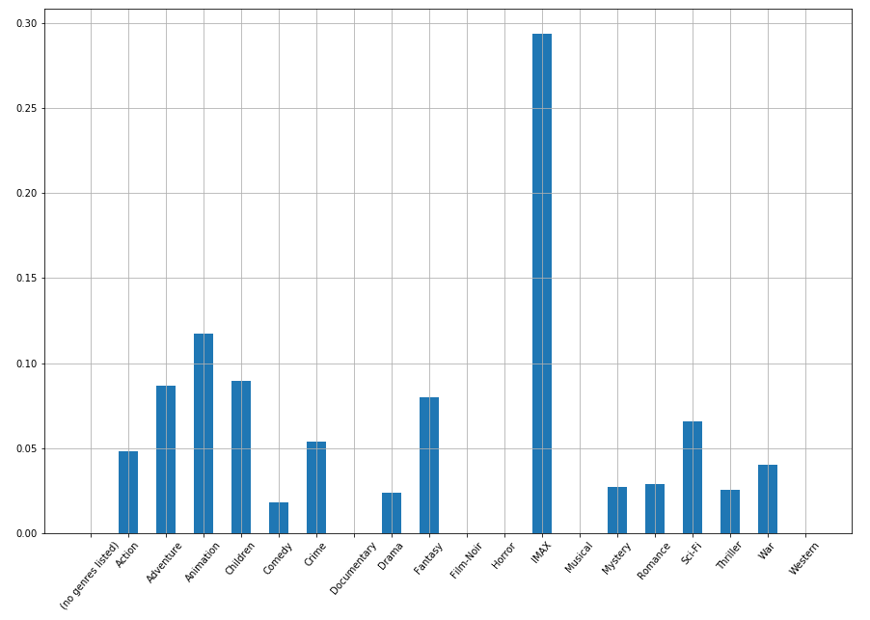
Genres after scaling
Cluster 9
IMAX(29%)
Animation (12%)
Children (9%)

Slide 19
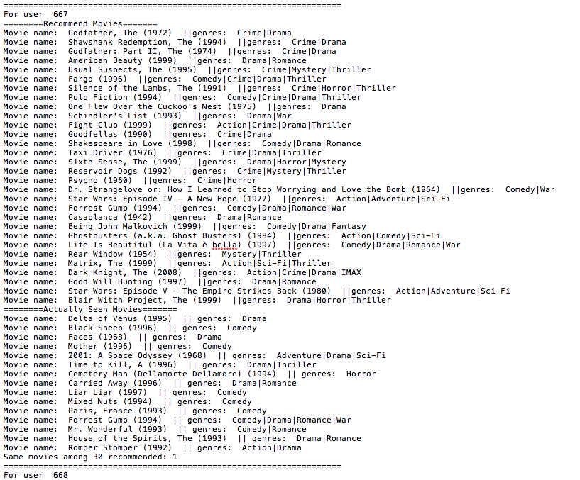
Recommend
Movies
For every users go through the encoder and kmeans to put him into a cluster. Then recommend those movies with highest scores rated by users in the same cluster to him.
Here we recommend 30 movies.

Slide 20
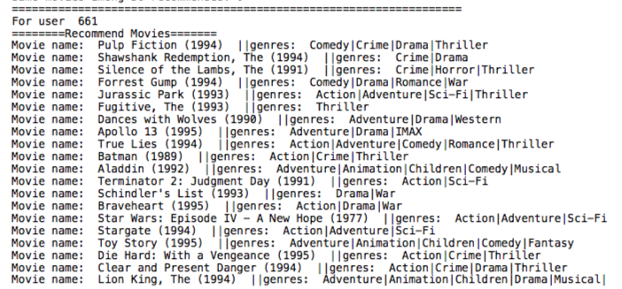
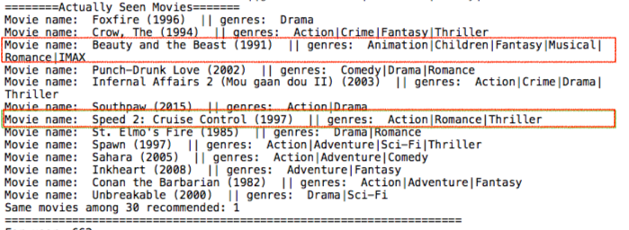
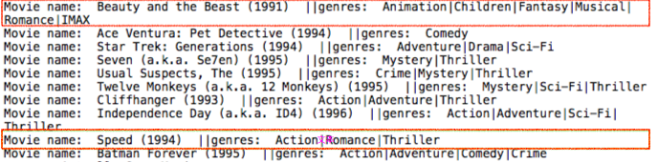
Test Case
Recommend 30 movies to this user based on his past watching history. Compare the results with those movies he most recently watched.
Recommend:
Beauty and the Beast
Speed
Actually watched:
Beauty and the Beast
Speed 2

